Slide 1
Refactoring

Slide 2
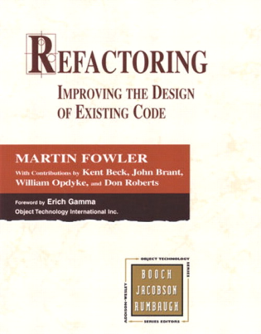
Refactoring is a redesign and reimplementation of code that preserves behavior but improves flow and clarity
No change in external behavior
Typically done at the function/method level
What kinds of things do we do?
Improve obviously bad code
Simplify control structures
Combine loops
Streamline selection statements
Extract out functions for duplicate behavior
Remove unnecessary code
We usually realize more about how to do something as we write the code the first time

Slide 3
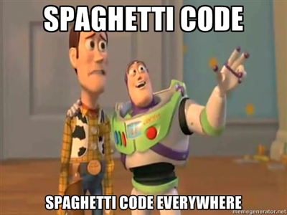
Problem: "Bit rot"
After several months and new versions, many codebases reach one of the following states:
rewritten : Nothing remains from the original code.
abandoned : Original code is thrown out, rewritten from scratch.
Why?
Systems evolve to meet new needs and add new features
If the code's structure does not also evolve, it will "rot"
This can happen even if the code was initially reviewed and well-designed at the time of checkin

Slide 4
Code maintenance
maintenance: Modification or repair of a software product after it has been delivered.
Purposes:
fix bugs
improve performance
improve design
add features
Studies have shown that ~80% of maintenance is for non-bug-fix-related activities such as adding functionality (Pigosky 1997).

Slide 5
Maintenance is hard
It's harder to maintain code than write your own new code.
“if it’s working, don’t touch it”
must understand code written by another developer, or code you wrote at a different time with a different mindset
most developers dislike code maintenance
Maintenance is how developers spend much of their time.
It pays to design software well and plan ahead so that later maintenance will be less painful.
Capacity for future change must be anticipated

Slide 6

Refactoring
refactoring: Improving a piece of software's internal structure without altering its external behavior.
Incurs a short-term time/work cost to reap long-term benefits
A long-term investment in the overall quality of your system.
refactoring is not the same thing as:
adding features
debugging code

Slide 7
Why refactor?
Why fix a part of your system that isn't broken?
Each part of your system's code has 3 purposes:
1. to execute its functionality,
2. to allow change,
3. to communicate well to developers who read it.
If the code does not do one or more of these, it is "broken."
Refactoring:
improves software's design
makes it easier to understand

Slide 8
When to refactor?
When is it best for a team to refactor their code?
best done continuously (like testing) as part of the process
hard to do well late in a project (like testing)
Refactor when you identify an area of your system that:
isn't well designed
isn't thoroughly tested, but seems to work so far
now needs new features to be added

Slide 9
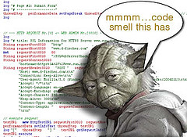
Signs you should refactor
code is duplicated
a routine is too long
a loop is too long or deeply nested
a class has poor cohesion
a class uses too much coupling
inconsistent level of abstraction
too many parameters
a class contains unused code
Code "smells"

Slide 10

Some types of refactoring
refactoring to fit design patterns
renaming (methods, variables)
extracting code into a method or module
splitting one method into several to improve cohesion and readability
changing method signatures
performance optimization
moving statements that semantically belong together near each other
naming (extracting) "magic" constants
exchanging idioms that are risky with safer alternatives
clarifying a statement that has evolved over time or is unclear
See also http://www.refactoring.org/catalog/

Slide 11
Refactoring plan, pt 1
Save / backup / checkin the code before you mess with it.
git!
Write unit tests that verify the code's external correctness.
They should pass on the current poorly designed code.
Having unit tests helps make sure any refactor doesn't break existing behavior (regressions).
Analyze the code to decide the risk and benefit of refactoring.
If it is too risky, not enough time remains, or the refactor will not produce enough benefit to the project, don't do it.

Slide 12
Refactoring plan, pt 2
(after completing steps on the previous slide)
Refactor the code.
Some unit tests may break. Fix the bugs.
Perform functional and/or integration testing. Fix any issues.
Code review the changes.
Check in your refactored code.
Keep each refactoring small; refactor one issue / unit at a time.
helps isolate new bugs and regressions
Your checkin should contain only your refactor.
NOT other changes such as adding features, fixing unrelated bugs.
Do those in a separate checkin.
(Resist temptation to fix small bugs or other tweaks; this is dangerous.)

Slide 13
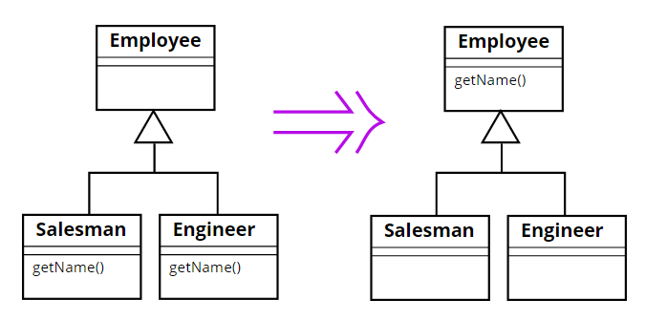
Example: Pull Up Method

Slide 14
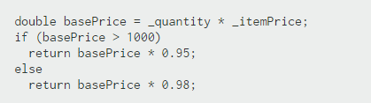

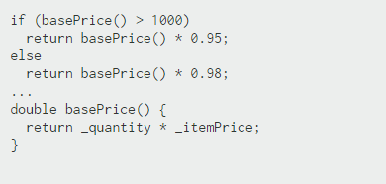
Example: Replace Temp variable with Query

Slide 15

Example: Extract Method
public class Customer { public int foo() {
... ... //compute score score = a*b+c; score *= xfactor; return score; } }
public class Customer { public int foo() { ... score = computeScore(a, b, c); } public int computeScore(int a, int b, int c) { return (a*b+c)*xfactor; } }

Slide 16
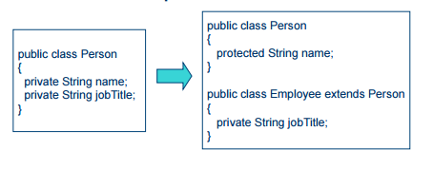
Example: Extract Subclass

Slide 17
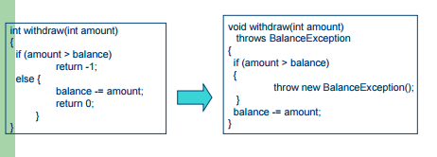
Example: Replace Error Code with Exception

Slide 18
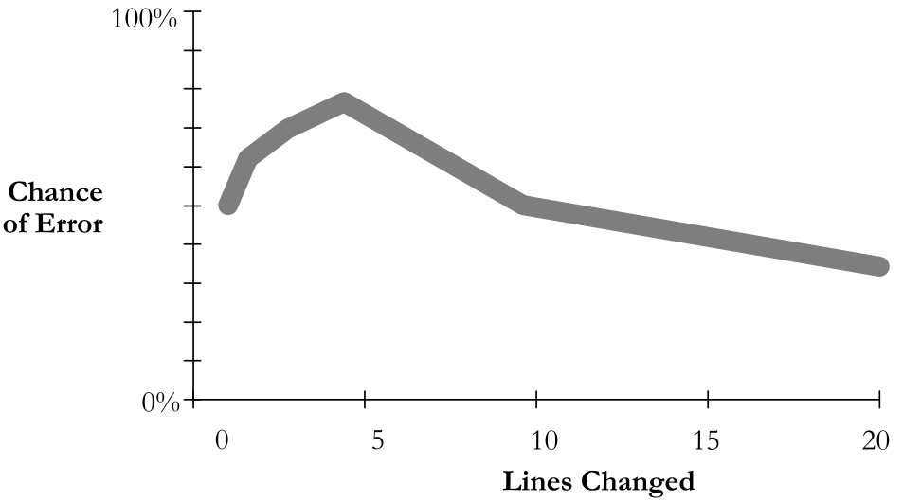
Dangers of refactoring
code that used to be ...
well commented, now (maybe) isn't
fully tested, now (maybe) isn't
fully code reviewed, now (maybe) isn't
easy to insert a bug into previously working code (regression!)
a small initial change can have a large chance of error

Slide 19
Regressions
What if refactoring introduces new bugs in previously working functionality ("regressions")? How can this be avoided?
Code being refactored should have good unit test coverage, and other tests (system, integration) over it, before the refactor.
If such code is not tested, add tests first before refactoring.
If the method being tested goes away, the underlying functionality of that method should still be somewhere. So move the unit test to cover that new place in the code.

Slide 20
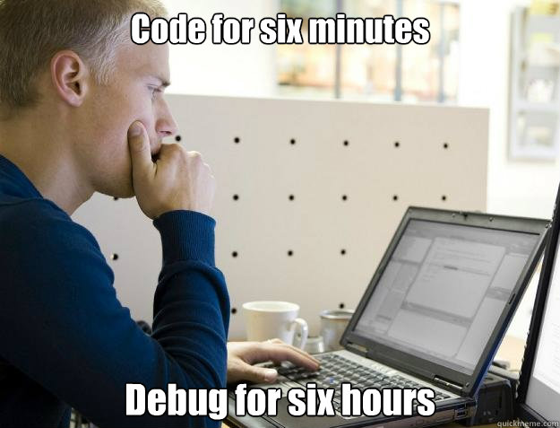

Slide 21
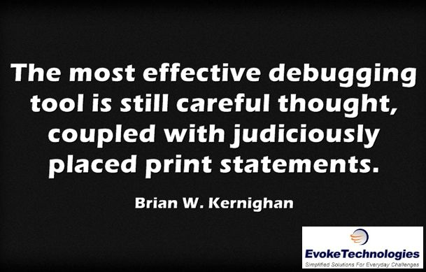
You want to become a good problem solver –
How?

